Slide 1
Future Trends of Security AI & ML
Server & Cloud Security
7

Slide 2
Objectives
Basics of AI & ML
Machine Learning Types
Supervised Learning
Unsupervised Learning
Semi-Supervised Learning
Reinforcement Learning
How Can AI Help Cybersecurity

Slide 3



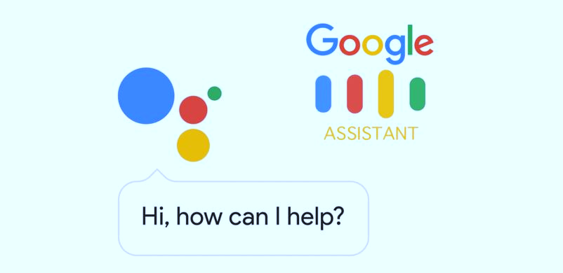
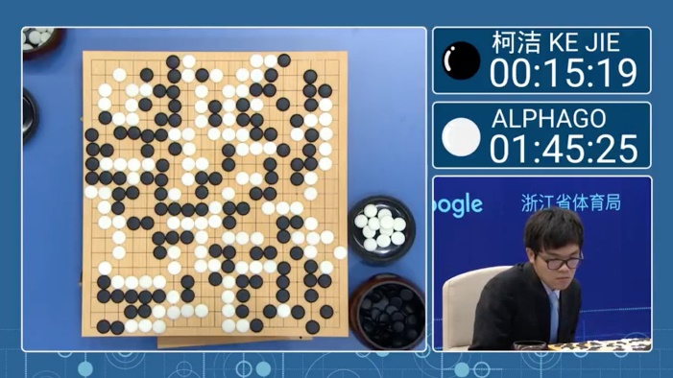
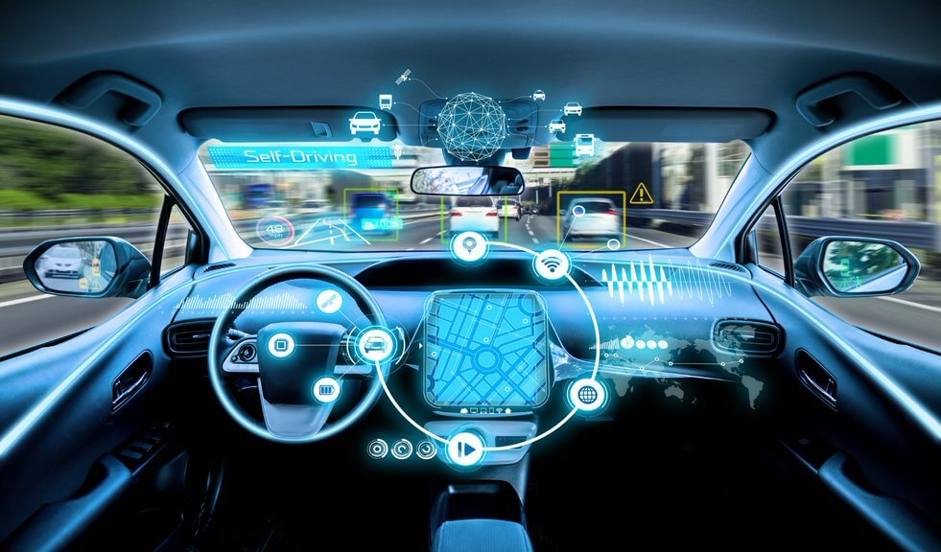
AI in Daily Life

Slide 4
Artificial intelligence (AI)
Artificial intelligence (AI) is a collective term for the capabilities shown by learning systems that are perceived by humans as representing intelligence.
Today, typical AI capabilities include speech, image and video recognition, autonomous objects, natural language processing, conversational agents, prescriptive modeling, augmented creativity, smart automation, advanced simulation, as well as complex analytics and predictions.

Slide 5
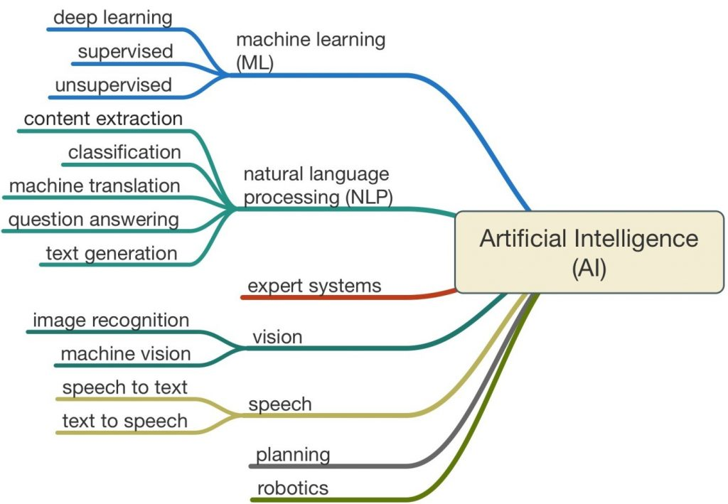
Machine Learning (ML)
Machine Learning (ML), is a subset of Artificial Intelligence (AI) that utilizes technologies to enable computers to learn and adapt through experience.

Slide 6
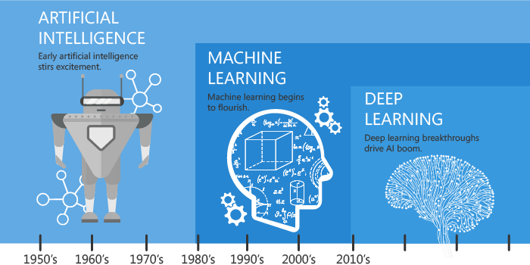
Artificial Intelligence & Machine Learning
Artificial intelligence (AI) is the intelligence demonstrated by machines, unlike the natural intelligence displayed by humans and animals.
Machine Learning (ML) is a subset of Artificial Intelligence (AI) that utilizes technologies to enable computers to learn and adapt through experience.

Slide 7
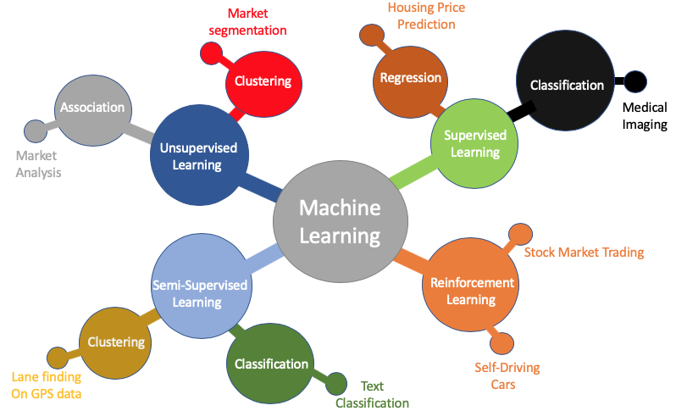
Machine Learning Methods

Slide 8
Machine Learning - Explained
Non-machine learning way
Apply some pre-defined formula
Need to reprogram for new conditions; such as speed, angle, etc.
Machine learning way
Identify the relationship from repeated success/failures
No need to reprogram for new conditions; just require more data

Slide 9
Machine Learning – In simpler terms
Another more technical definition
Machine learning is a type of artificial intelligence (AI) that provides computers with the ability to learn without being explicitly programmed.
Machine learning focuses on the development of computer programs that can change or improve when exposed to new data.
This means in machine learning for any task, a machine optimise it’s performance criterion based on data or past experience.

Slide 10
Why Machine Learning?
Beat humans in Image Recognition
Beat humans in Reading
Beat humans in Medical Tasks
Etc…..
This is NOT a HYPE, This is REAL!!!

Slide 11
Machine Learning Categories
Machine learning problems can be divided into three main categories according to the characteristics of the problem.
These are:
Supervised Learning;
Unsupervised Learning;
Semi-supervised Learning, and
Reinforcement Learning

Slide 12
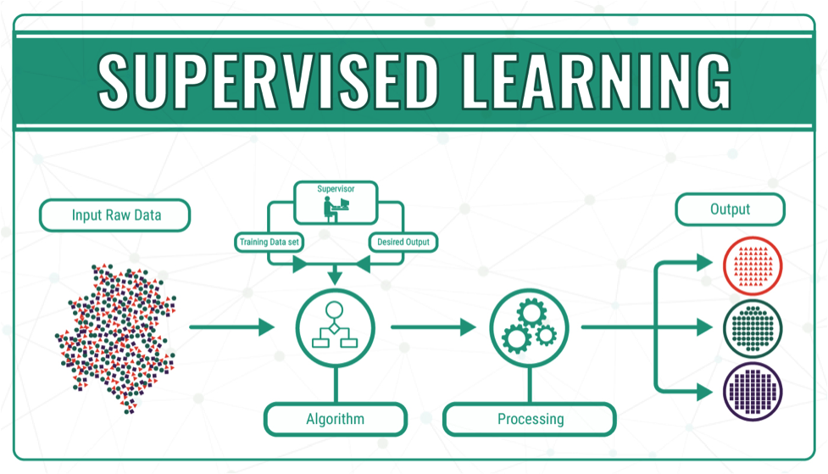
1. Supervised Learning

Slide 13
Supervised Learning
We have pre-known answers to some of the data (labelled data).
For example, “I know what bad behaviour looks like”
Supervised learning techniques divided into two subcategories:
Classification; and
Regression.

Slide 14
Application Types
The outcome that we are interested in is called the target variable.
In supervised learning, there is always a target variable (which must have labelled example data).
The applications depends on:
the target variable type (numerical value or categorical); and
the input data (numerical value, categorical or unstructured data such as logs or images.

Slide 15
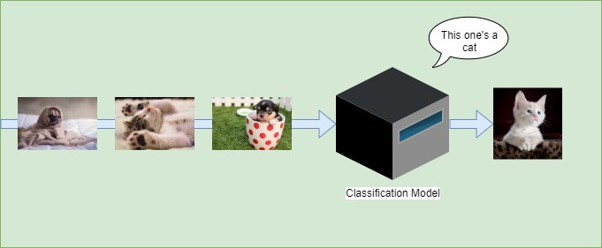
Supervised Learning - Classification
The main idea is to completely divided classes and main work is defining test sample to find the class which actually belongs to
For example, the need to classify images as either eagles or pigeons.

Slide 16

Classification Examples in Security
For every file sent through the network, does it contain malware?
For every login attempt, has someone’s password been compromised?
For every email received, is it a phishing attempt?
For every request to your services, is it a denial of service (DoS) attack?
For every outbound request from your network, is it a bot communicating with its command-and-control server?

Slide 17
Supervised Learning - Regression
When our dataset classes are not separate, so it means we have continuous data.
The main idea is to estimate the correct numerical value for the target variable.
Regression will not give a class as output but a specific value also called a forecast or prediction.
For example, the need to forecast the retail sales for different products in a store.

Slide 18
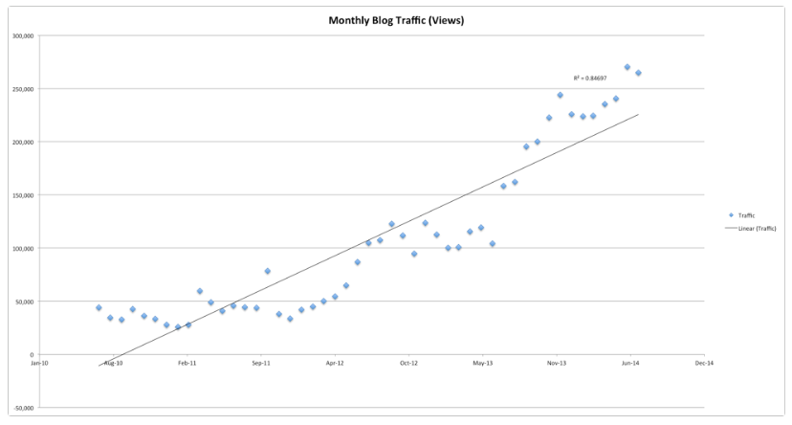
Regression

Slide 19
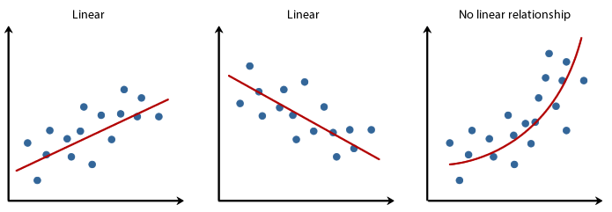
Regression Examples in Security
Predict the number of phishing emails an employee will receive in a given month given historical data about phishing emails and the employee.
Predict the number of account sign-ins form a specific user or a specific office location given a known history.
Predict the number of database requests during a specific time period.

Slide 20
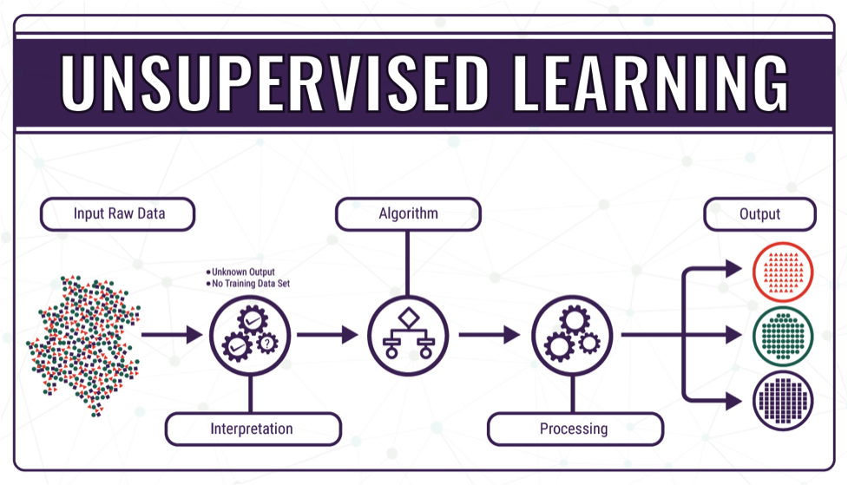
2. Unsupervised Learning

Slide 21
Unsupervised Learning
Unsupervised learning is a machine learning technique, where you do not need to supervise the model.
We DO NOT have pre-known answers to the data set (labelled data).
The machine learning algorithm must discover information by itself on:
groups of data (clustering); or
relationships (association).

Slide 22
Unsupervised Learning - Clustering
Clustering is an important concept in unsupervised learning.
It attempts to find a structure or pattern in a collection of uncategorised data.
Clustering algorithms will process the data and find natural clusters or groups if they exist in the data.
Possible to modify how many clusters the algorithms should identify.
The granularity of these groups can also be adjusted.

Slide 23
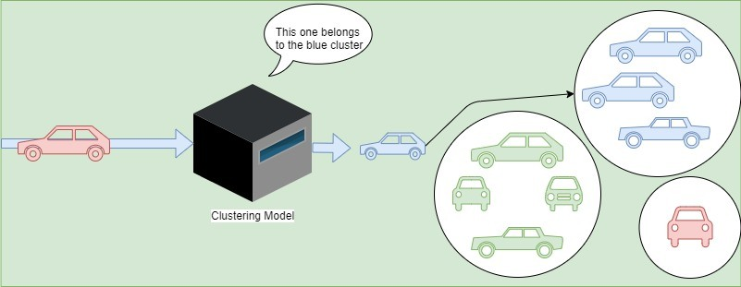
Clustering Example
For example, we have inputs consisting of cars. Besides, the dataset is not labeled, we have no idea what their similar features or set of features could lead to as clusters.
The clustering model will find patterns. As an illustration, in the case presented below, it finds a way of grouping cars using their respective colors:

Slide 24
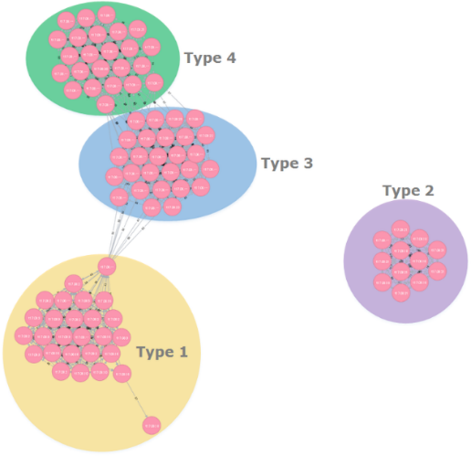
Clustering Examples in Security
Given a large dataset of internet traffic to your site, you may want to know which requests group together – some may be botnets, others may be legitimate users. You could do this using request times, frequency, source, etc.
Given a large group of malware samples you may want to know how they group into malware families.
Given online chatter or descriptions of vulnerabilities, you may want to know what are the different kinds of vulnerabilities that are out there.

Slide 25
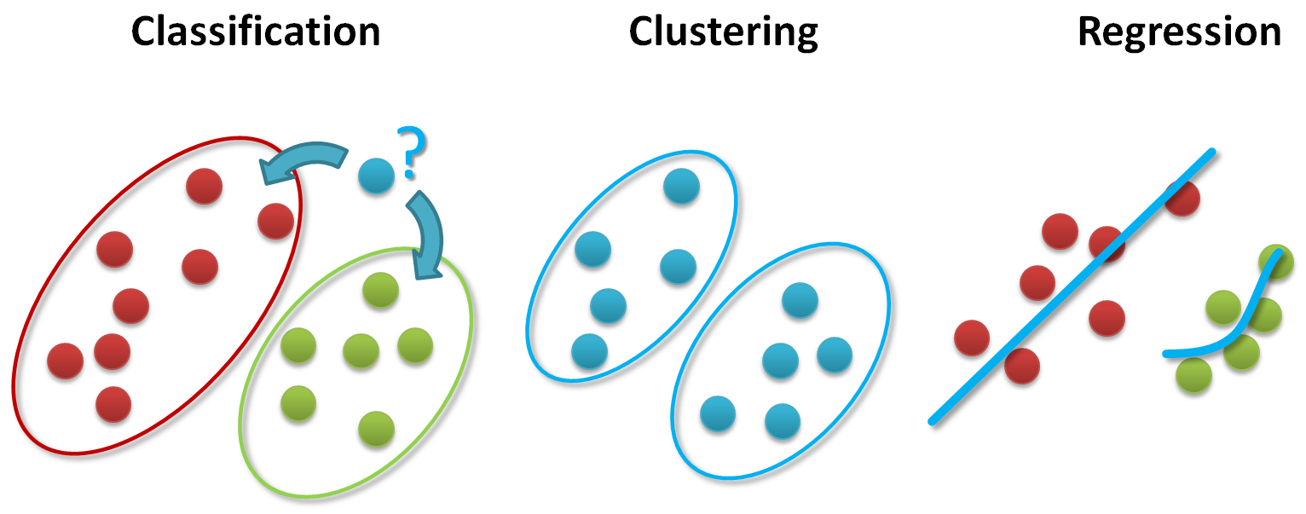
Recap
The figure below shows an overview of the commonly adopted three different areas to analyze big data:

Slide 26
Unsupervised Learning - Association
Association learning is a rule based machine learning and data mining technique that finds important relations between variables or features in a data set.
Unlike conventional association algorithms measuring degrees of similarity, association rule learning identifies hidden correlations in databases by applying some measure of interestingness to generate an association rule for new searches.

Slide 27
Association Example
In a store with a million transactions a year, 10,000 (1%) sales might include newborn baby diapers and 100,000 (10%) include razor blades.
At first glance, newborn diapers and razors seem statistically independent, with no apparent correlation. But rule mining would dig deeper into the transaction frequency and find out that 5,000 sales include both items.
So instead of simply learning that 1% of shoppers buy diapers and 10% buy razor blades, the association system generates a new rule that 50% of all shoppers purchasing newborn diapers will also buy razor blades, which can be beneficial information for marketing campaigns.

Slide 28
Association Examples in Security
Association rule mining – Based on a large data set of the intrusion detection logs, find the existence of causal relationships between an attacker and the combination of alarms as a result of their behavior in a network.

Slide 29
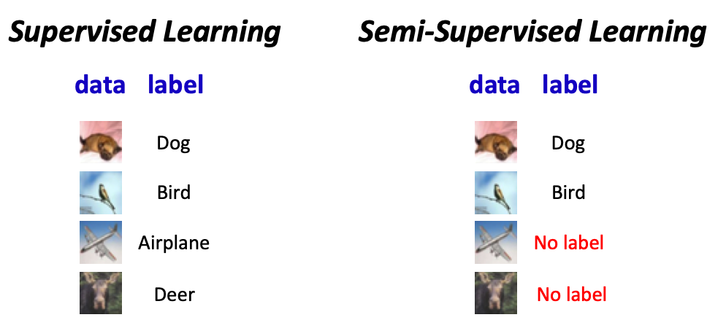
3. Semi-Unsupervised Learning

Slide 30
Semi-Supervised Learning
Similarly to supervised and unsupervised learning, semi-supervised learning consists of working with a dataset.
However, datasets in semi-supervised learning are split into two parts: a labeled part and an unlabeled one.
This technique is often used when labeling the data or gathering labeled data is too difficult or too expensive. The part of the data labeled can also be of bad quality.

Slide 31
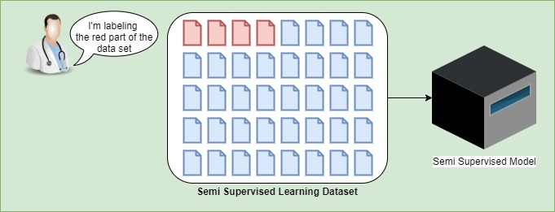
Semi-Supervised Learning (Cont’d)
For example, if we take medical imaging to detect cancer, having doctors labeling the dataset is a very expensive task. Moreover, those doctors have other more urgent work to do.
So the doctor may label part of the dataset and left the other one unlabeled.
This technique of machine learning has proven to perform good accuracy even if the dataset is partially labeled.

Slide 32
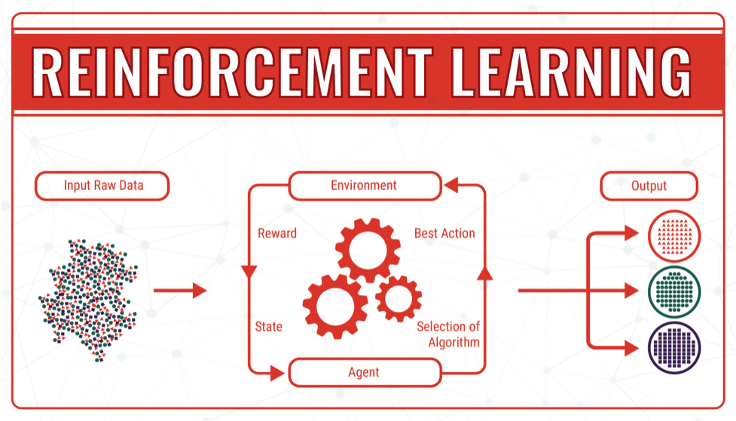
4. Reinforcement Learning

Slide 33
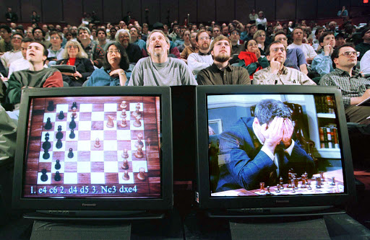
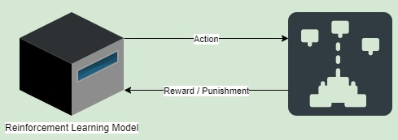
Reinforcement Learning
Reinforcement learning occurs when you present the algorithm with examples that lack labels, as in unsupervised learning.
However, you can accompany an example with positive or negative feedback according to the solution the algorithm proposes.
Positive ones are known as “rewards” while negative ones are known as “punishments”.
In the human world, it is just like learning by trial and error.
An interesting example of reinforcement learning occurs when computers learn to play video games by themselves.
The system gets a reward when it wins more points. But then, if it loses, the model will receive a punishment. As a result, the model can then identify what moves were good in terms of strategy.

Slide 34
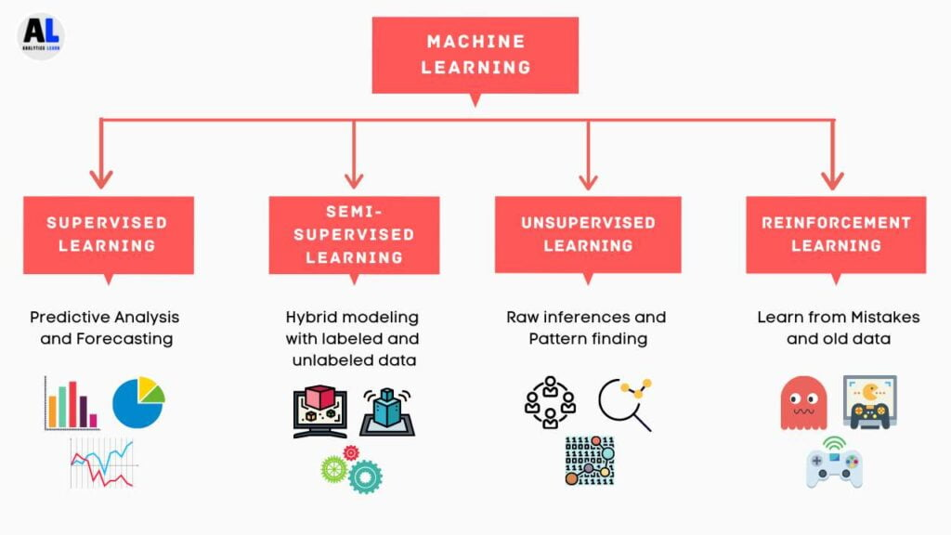
Summary of Machine Learning Types

Slide 35
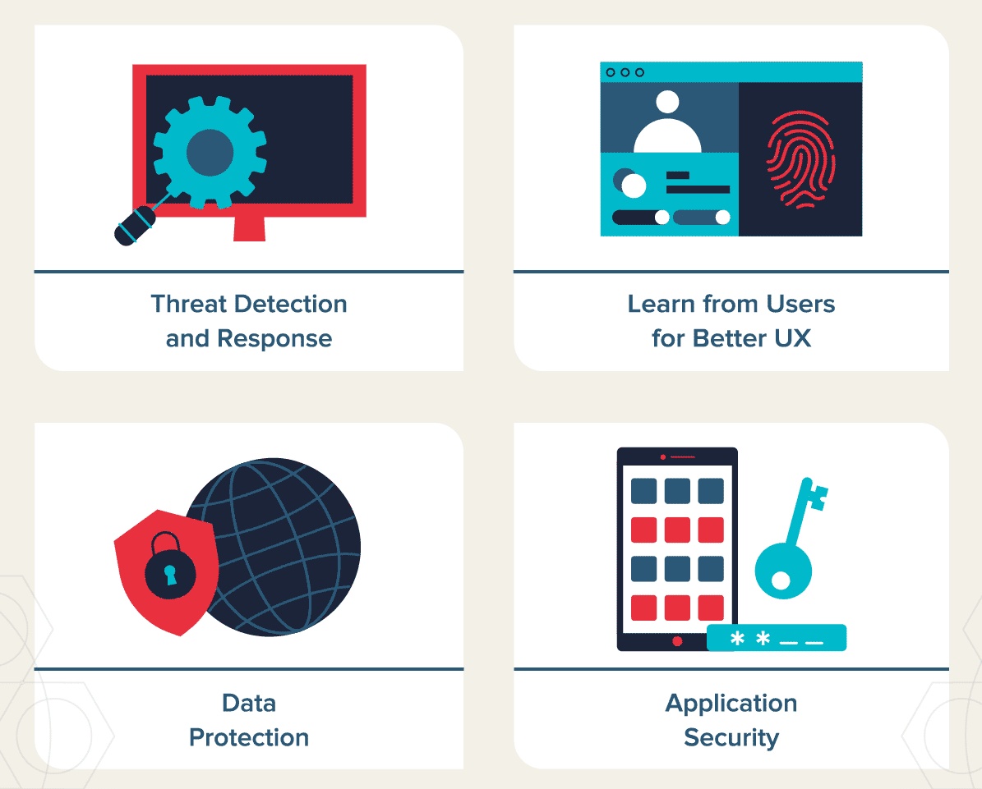
How Can AI Help Cybersecurity?

Slide 36
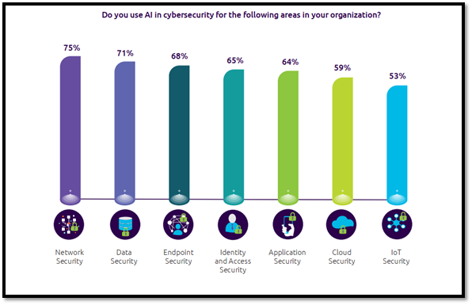
Top Artificial Intelligence Use Cases for Cybersecurity

Slide 37
How Can AI Help Cybersecurity?
We will understand how AI can be leveraged to innovate, improve and enhance work and processes in the area of cybersecurity through the following steps.
For each security functions, the current practices can be greatly improved by leveraging AI.
Security Functions
Current Practices
AI’s Roles & Opportunities

Slide 38

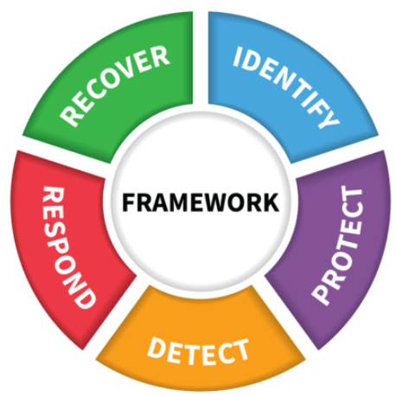
The Five Functions of Cybersecurity
According to NIST, for organizations to have a successful and holistic cybersecurity program, they should focus on the five functions of cybersecurity.
Identify, Protect, Detect, Respond and Recover are the five pillars of the cybersecurity framework.

Slide 39
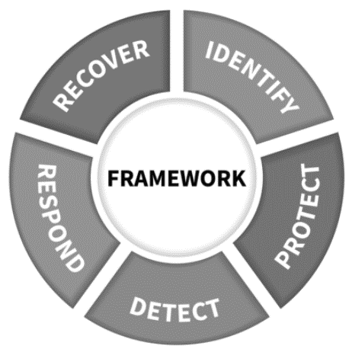

1 - The Identify Function (Optional)
The Identify Function assists in developing an organizational understanding of managing cybersecurity risk to systems, people, assets, data, and capabilities
Current Practices:
Identifying physical and software assets to establish an Asset Management program
Identifying cybersecurity policies to define a Governance program
Identifying a Risk Management Strategy for the organization

Slide 40
AI’s Roles & Opportunities (Optional)
Risk Management Use Cases:
Company Cybersaint offers solutions for streamlining the cyber-risk compliance process.
Company Wiretap, which helps secure enterprise social networks, as well as collaboration tools, by securing against intellectual property and confidential data leaks, insider threats, HR policy violations, compliance issues, and external sharing risks.
Automated Security Use Case:
Company Demisto offers systems that are designed to automate security tasks across 100+ security products and coordinate human analyst activities and workflows together.

Slide 41

2- The Protect Function
The Protect Function supports the ability to limit or contain the impact of potential cybersecurity events and outlines safeguards for delivery of critical services
Current Practices:
Establishing Data Security protection to protect the confidentiality, integrity, and availability
Managing Protective Technology to ensure the security and resilience of systems
Empowering staff within the organization through Awareness and Training

Slide 42
Current Practices - Examples
Firewalls, WAF (Web Application Firewall);
IPS (Intrusion Prevention System);
Antivirus/Endpoint Protection, Encryption;
VPN (Virtual Private Network);
IAM (Identity and Access Management);
EMM (Enterprise Mobility Management).
Anti-APT – advanced protection from Advance Persistent Threats.

Slide 43
AI Firewall
An artificial intelligence (AI) firewall uses intelligent detection technologies to improve the capability of detecting advanced threats and unknown threats.
The AI firewall uses the intelligent detection engine to train threat detection models based on massive samples and continuously optimize the models based on real-time traffic data, improving threat detection capabilities.

Slide 44
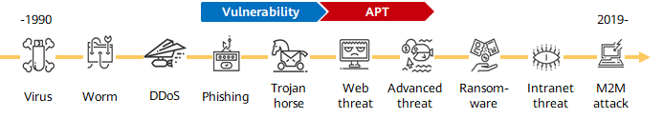
AI Firewall
In addition to traditional threats such as viruses and Trojan horses, advanced threats, for example, advanced persistent threats (APTs), are constantly evolving.
As a result, attacks such as ransomware and M2M (machine-to-machine) attacks are becoming increasingly diversified, due to huge economic benefits.
Advanced threats are more covert and spread faster, and up to 70% of network attack traffic is encrypted.
Signature-based threat detection cannot cope with advanced and unknown threats

Slide 45
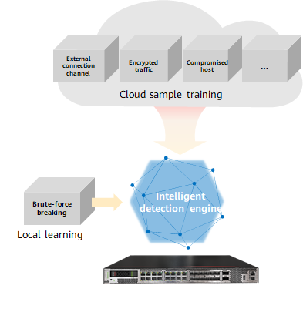
AI Firewall Detection of Advanced Threats
The detection models used by the intelligent detection engine come from the following:
Cloud Sample Training (Supervised Learning)
The cloud uses supervised learning to train millions of samples, extracts threat detection models, and delivers the models to firewalls for detection.
Local Learning (Unsupervised Learning)
Unsupervised learning is used locally, and the learning is performed continuously by extracting data from live network traffic.

Slide 46
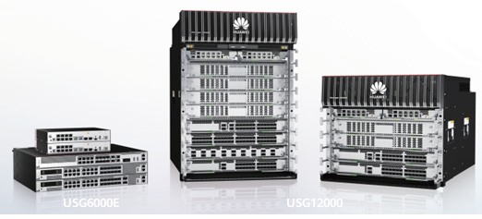
AI Firewall Detection of Advanced Threats
Supervised learning and unsupervised learning can more effectively detect malicious files that are frequently mutated, detect compromised hosts and remotely controlled zombies, monitor encrypted data that is sent and stolen, and identify malicious behavior, such as slow and distributed brute force attacks.
During the learning process, mass data analysis is leveraged to train and generate threat detection models, and the models are continuously optimized based on live network data for self-evolution.
The updated model trained on the cloud is delivered directly to a firewall without the need to upgrade system software.
Huawei AI firewall products

Slide 47
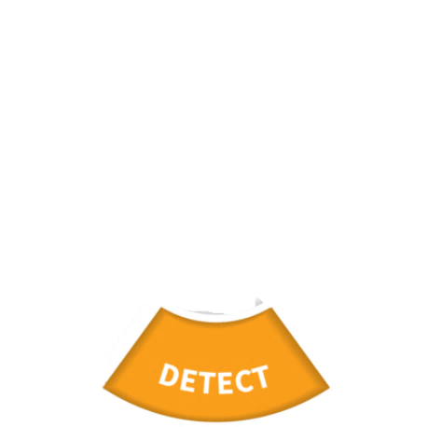
3- The Detect Function
The Detect Function defines the appropriate activities to identify the occurrence of a cybersecurity event in a timely manner
Current Practices
Implementing Security Continuous Monitoring capabilities to monitor cybersecurity events
Ensuring Anomalies and Events are detected, and their potential impact is understood through tools like SIEM
Verifying the effectiveness of protective measures

Slide 48
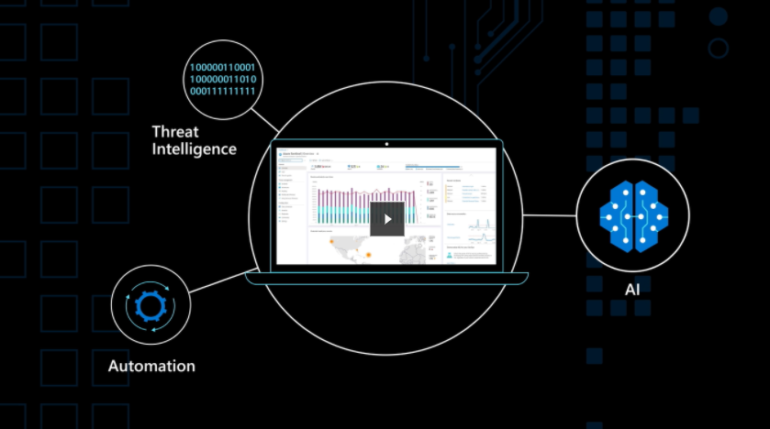
Cloud-native, AI-enabled SIEM Solution
Microsoft Azure Sentinel:
Collect data at cloud scale—across all users, devices, applications, and infrastructure, both on-premises and in multiple clouds;
Detect previously uncovered threats and minimize false positives using analytics and unparalleled threat intelligence from Microsoft;
Investigate threats with AI and hunt suspicious activities at scale, tapping into decades of cybersecurity work at Microsoft;
Respond to incidents rapidly with built-in orchestration and automation of common tasks.

Slide 49

4- The Respond Function (Optional)
The Respond Function includes appropriate activities to take action regarding a detected cybersecurity incident to minimize impact
Current Practices:
Incident Management/Response
Ensuring Response Planning processes are executed during and after an incident
Managing Communications during and after an event
Analyzing effectiveness of response activities

Slide 50
Machine Learning for Incident Response (Optional)
By embracing incident response tools and strategies that leverage machine learning and automation, IT teams can resolve the challenges described above and achieve a faster, more predictable and more efficient approach to incident response.
(a) Assigning incident response duties
First and foremost, machine learning can automatically make suggestions regarding which engineers should respond to an incident on the basis of the nature of the incident
(b) Faster, more accurate incident detection and correlation
Machine learning simplifies and automates the process of determining which behavior within an application environment constitutes an incident. It can help to categorize the seriousness of the incident. It can also understand whether and how two or more incidents might be related to each other.

Slide 51

5- The Recover Function (Optional)
The Recover Function identifies appropriate activities to maintain plans for resilience and to restore services impaired during cybersecurity incidents
Current Practices:
Ensuring the organization implements Recovery Planning processes and procedures
Implementing improvements based on lessons learned
Coordinating communications during recovery activities

Slide 52
Machine learning for Incident Recovery (Optional)
(a) Automated remediation
By using machine learning to analyze the cause of an incident and determine how to resolve it, tools can take action automatically, especially in cases where the necessary fix is relatively simple and easily automated.
(b) Identifying opportunities for long-term improvement
Machine learning can be used to assess data from multiple incidents over the long term in order to identify ways in which the overall reliability and efficiency of a system can be improved.

Slide 53
Summary
Basics of AI & ML
Machine Learning Types
Supervised Learning
Unsupervised Learning
Semi-Supervised Learning
Reinforcement Learning
How Can AI Help Cybersecurity

